Slide 1
Clipping

Slide 2

2D Clipping

Slide 3

Viewing in 2D
250°
45°
Window in world coordinates.
250 x 250
Pixels.
Viewport in
Device coords

Slide 4
Viewing in 2D
In 2D, a ‘world’ consists of an infinite plane, defined in ‘world’ coordinates, i.e metres, angstroms etc.
We need to pick an area of the 2D plane to view, referred to as the ‘window’.
On our display device, need to allocate an area for display, referred to as the ‘viewport’ in device specific coordinates.
  Clip objects outside of window.
  Translate to fit viewport.
  Scale to device coordinates.

Slide 5
Clipping Primitives
Different primitives can be handled in different ways
  Points
  Lines
  Polygons

Slide 6
Windowing I
A scene is made up of a collection of objects specified in world coordinates
World Coordinates

Slide 7
Windowing II
When we display a scene only those objects within a particular window are displayed
Window
wy_{max}
wy_{min}
wx_{min}
wx_{max}
World Coordinates

Slide 8
Windowing III
Because drawing things to a display takes time we clip everything outside the window
Window
wy_{max}
wy_{min}
wx_{min}
wx_{max}
World Coordinates

Slide 9
The Two-Dimensional Viewing Pipeline
A section of a two-dimensional scene that is selected for display is called a clipping window because all parts of the scene outside the selected section are “clipped” off. The only part of the scene that shows up on the screen is what is inside the clipping window. Sometimes the clipping window is alluded to as the world window or the viewing window.
Graphics packages allow us also to control the placement within the display window using another “window” called the viewport. Objects inside the clipping window are mapped to the viewport, and it is the viewport that is then positioned within the display window. The clipping window selects what we want to see; the viewport indicates where it is to be viewed on the output device.

Slide 10
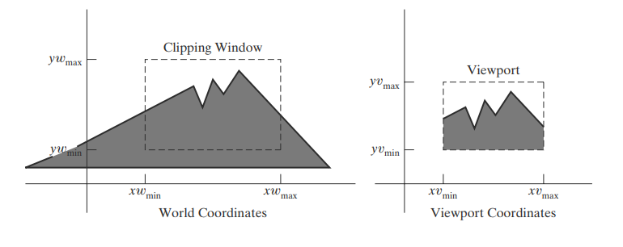

Slide 11
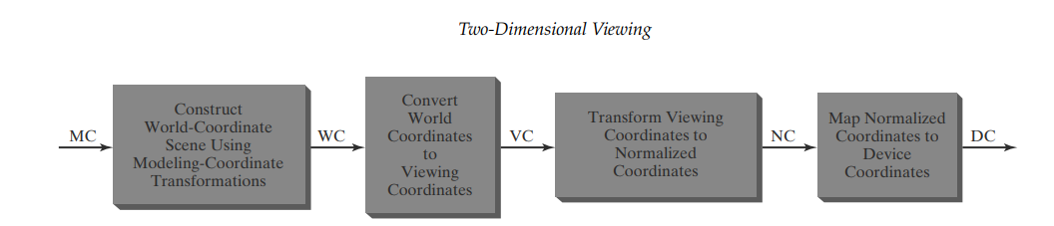

Slide 12
Clipping
For the image below consider which lines and points should be kept and which ones should be clipped
P₄
Window
P₂
wy_{max}
P₃
P₆
P₁
P₇
P₅
P₉
P₈
wy_{min}
P₁₀
wx_{min}
wx_{max}

Slide 13
Trivial acceptance.
All line vertices lie inside box → accept.

Slide 14
Point Clipping
Easy - a point (x,y) is not clipped if:
wx_{min} ≤ x ≤ wx_{max} AND wy_{min} ≤ y ≤ wy_{max}
otherwise it is clipped
P₄
Clipped
Clipped
Window
P₂
wy_{max}
Clipped
P₅
P₇
P₁
Points Within the Window are Not Clipped
P₉
P₈
wy_{min}
Clipped
P₁₀
wx_{min}
wx_{max}

Slide 15
Line Clipping
Harder - examine the end-points of each line to see if they are in the window or not
Situation | Solution | Example
Both end-points inside the window | Don’t clip
One end-point inside the window, one outside | Must clip
Both end-points outside the window | Don’t know!

Slide 16
Clipping Algorithms
Generally, any procedure that eliminates those portions of a picture that are either inside or outside a specified region of space is referred to as a clipping algorithm or simply clipping.
Usually a clipping region is a rectangle in standard position, although we could use any shape for a clipping application.

Slide 17
In the following sections, we explore two-dimensional algorithms for
Point clipping
Line clipping (straight-line segments)
Fill-area clipping (polygons)
Curve clipping
Text clipping

Slide 18
Two-Dimensional Point Clipping
For a clipping rectangle in standard position, we save a two-dimensional point P = (x, y) for display if the following inequalities are satisfied:
xwmin ≤ x ≤ xwmax
ywmin ≤ y ≤ ywmax
If any of these four inequalities is not satisfied, the point is clipped (not saved for display).

Slide 19
Although point clipping is applied less often than line or polygon clipping, it is useful in various situations, particularly when pictures are modeled with particle systems. For example, point clipping can be applied to scenes involving clouds, sea foam, smoke, or explosions that are modeled with “particles,” such as the center coordinates for small circles or spheres.

Slide 20
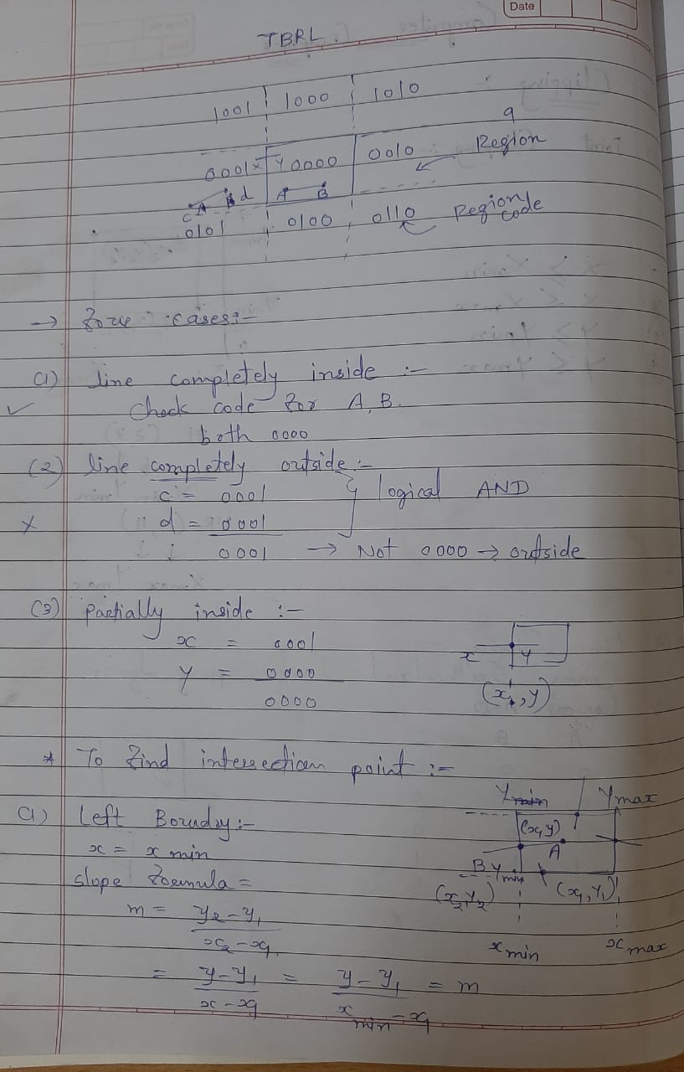
Point Clipping

Slide 21
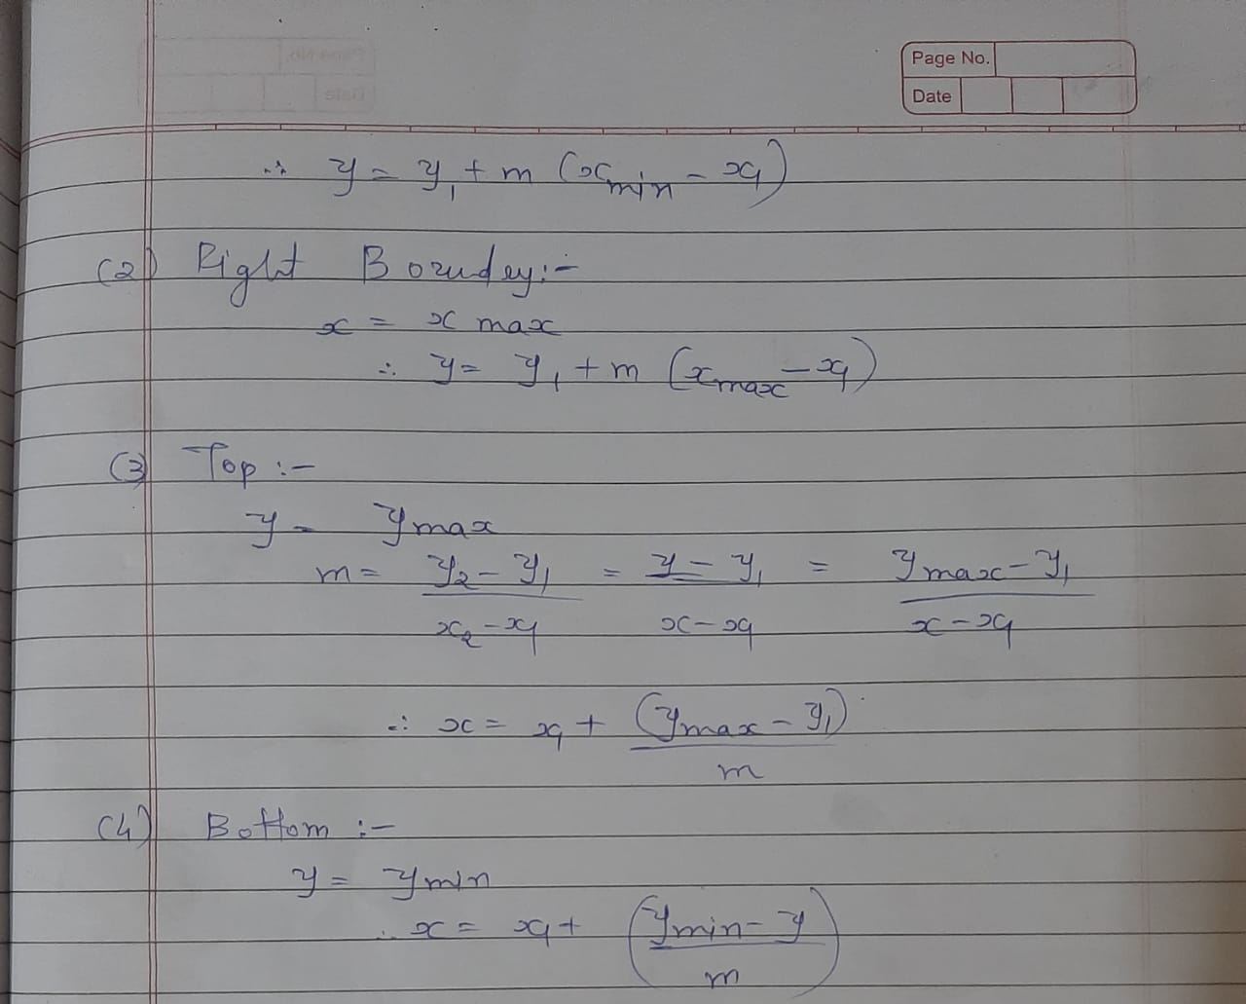

Slide 22
Two-Dimensional Line Clipping
A line-clipping algorithm processes each line in a scene through a series of tests and intersection calculations to determine whether the entire line or any part of it is to be saved.
The expensive part of a line-clipping procedure is in calculating the intersection positions of a line with the window edges. Therefore, a major goal for any line-clipping algorithm is to minimize the intersection calculations.

Slide 23
Cohen-Sutherland Algorithm
Dispense Two Simpler Case
Trivially accept / Visible
Trivially reject / Not Visible

Slide 24
Brute Force Line Clipping
Brute force line clipping can be performed as follows:
  Don’t clip lines with both
  end-points within the
  window
  For lines with one end-
  point inside the window
  and one end-point
  outside, calculate the
  intersection point (using the equation of the line) and clip from this point out

Slide 25
Brute Force Line Clipping (cont…)
  For lines with both end-points outside the window test the line for intersection with all of the window boundaries, and clip appropriately
However, calculating line intersections is computationally expensive
Because a scene can contain so many lines, the brute force approach to clipping is much too slow

Slide 26
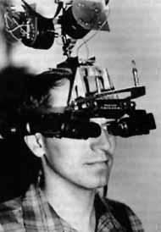

Cohen-Sutherland Clipping Algorithm
An efficient line clipping algorithm
The key advantage of the algorithm is that it vastly reduces the number of line intersections that must be calculated
Dr. Ivan E. Sutherland co-developed the Cohen-Sutherland clipping algorithm. Sutherland is a graphics giant and includes amongst his achievements the invention of the head mounted display.
Cohen is something of a mystery – can anybody find out who he was?

Slide 27
Cohen-Sutherland Clipping

Slide 28
Cohen-Sutherland Algorithm [2/4]
Test for trivial acceptance or rejection
P
1
0
0
0
1
0
0
1
1
0
1
0
0
0
0
1
0
0
0
0
0
0
1
0
0
1
0
1
0
1
1
0
0
1
0
0
A
B
R
L
P =
1
0
0
1
Trivial accept: Codes for both end points are 0000
Trivial reject: Codes for both end points have a 1 in the same position.

Slide 29
Cohen-Sutherland: World Division
World space is divided into regions based on the window boundaries
  Each region has a unique four bit region code
  Region codes indicate the position of the regions with respect to the window
1001 | 1000 | 1010
0001 | 0000 Window | 0010
0101 | 0100 | 0110
3
2
1
0
above
below
right
left
Region Code Legend

Slide 30
Cohen-Sutherland: Labelling
Every end-point is labelled with the appropriate region code
P₁₁ [1010]
P₄ [1000]
Window
wy_{max}
P₆ [0000]
P₃ [0001]
P₅ [0000]
P₁₂ [0010]
P₇ [0001]
P₉ [0000]
P₈ [0010]
wy_{min}
P₁₀ [0100]
P₁₃ [0101]
P₁₄ [0110]
wx_{min}
wx_{max}

Slide 31
Cohen-Sutherland: Lines In The Window
Lines completely contained within the window boundaries have region code [0000] for both end-points so are not clipped
P₁₁ [1010]
P₄ [1000]
Window
wy_{max}
P₆ [0000]
P₃ [0001]
P₅ [0000]
P₁₂ [0010]
P₇ [0001]
P₉ [0000]
P₈ [0010]
wy_{min}
P₁₀ [0100]
P₁₃ [0101]
P₁₄ [0110]
wx_{min}
wx_{max}

Slide 32
Cohen-Sutherland: Lines Outside The Window
Any lines with a common set bit in the region codes of both end-points can be clipped
  The AND operation can efficiently check this
P₁₁ [1010]
P₄ [1000]
Window
wy_{max}
P₆ [0000]
P₃ [0001]
P₅ [0000]
P₁₂ [0010]
P₇ [0001]
P₉ [0000]
P₈ [0010]
wy_{min}
P₁₀ [0100]
P₁₃ [0101]
P₁₄ [0110]
wx_{min}
wx_{max}

Slide 33
Clipping
analytically calculating the portions of primitives within the viewport

Slide 34
Cohen-Sutherland: Other Lines
Lines that cannot be identified as completely inside or outside the window may or may not cross the window interior
These lines are processed as follows:
  Compare an end-point outside the window to a boundary (choose any order in which to consider boundaries e.g. left, right, bottom, top) and determine how much can be discarded
  If the remainder of the line is entirely inside or outside the window, retain it or clip it respectively

Slide 35
Cohen-Sutherland: Other Lines (cont…)
  Otherwise, compare the remainder of the line against the other window boundaries
  Continue until the line is either discarded or a segment inside the window is found
We can use the region codes to determine which window boundaries should be considered for intersection
  To check if a line crosses a particular boundary we compare the appropriate bits in the region codes of its end-points
  If one of these is a 1 and the other is a 0 then the line crosses the boundary

Slide 36
Cohen-Sutherland Examples
Consider the line P₉ to P₁₀ below
  Start at P₁₀
  From the region codes
  of the two end-points we
  know the line doesn’t
  cross the left or right
  boundary
  Calculate the
  intersection of the line with the bottom boundary to generate point P₁₀’
  The line P₉ to P₁₀’ is completely inside the window so is retained
Window
wy_{max}
P₉ [0000]
P₉ [0000]
wy_{min}
P₁₀’ [0000]
P₁₀ [0100]
wx_{min}
wx_{max}

Slide 37
Cohen-Sutherland Examples (cont…)
Consider the line P₃ to P₄ below
  Start at P₄
  From the region codes
  of the two end-points
  we know the line
  crosses the left
  boundary so calculate
  the intersection point to
  generate P₄’
  The line P₃ to P₄’ is completely outside the window so is clipped
P₄’ [1001]
P₄ [1000]
Window
wy_{max}
P₃ [0001]
P₃ [0001]
wy_{min}
wx_{min}
wx_{max}

Slide 38
Cohen-Sutherland Examples (cont…)
Consider the line P₇ to P₈ below
  Start at P₇
  From the two region
  codes of the two
  end-points we know
  the line crosses the
  left boundary so
  calculate the
  intersection point to
  generate P₇’
Window
wy_{max}
P₇’ [0000]
P₇ [0001]
P₈ [0010]
P₈’ [0000]
wy_{min}
wx_{min}
wx_{max}

Slide 39
Cohen-Sutherland Examples (cont…)
Consider the line P₇’ to P₈
  Start at P₈
  Calculate the
  intersection with the
  right boundary to
  generate P₈’
  P₇’ to P₈’ is inside
  the window so is
  retained
Window
wy_{max}
P₇’ [0000]
P₇ [0001]
P₈ [0010]
P₈’ [0000]
wy_{min}
wx_{min}
wx_{max}

Slide 40
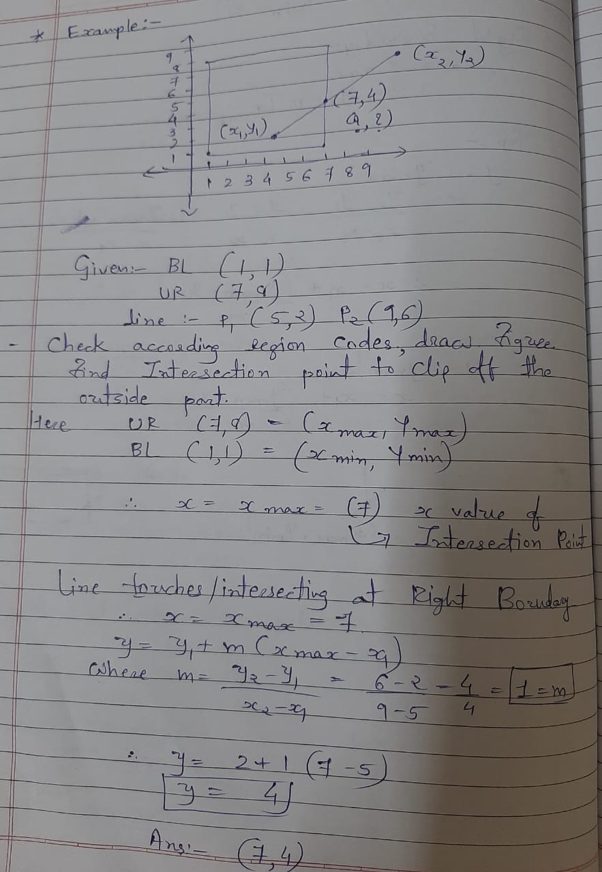
Example: Cohen Sutherland line clipping algorithm

Slide 41

Mid Point Subdivision Line Clipping Algorithm:
It is used for clipping line. The line is divided in two parts. Mid points of line is obtained by dividing it in two short segments. Again division is done, by finding midpoint.
This process is continued until line of visible and invisible category is obtained. Let (x_{i},y_{i}) are midpoint,

Slide 42
Mid Point Subdivision Line Clipping Algorithm:
Step1: Calculate the position of both endpoints of the line
Step2: Perform OR operation on both of these endpoints
Step3: If the OR operation gives 0000
then
Line is guaranteed to be visible
else
Perform AND operation on both endpoints.
If AND ≠ 0000
then the line is invisible
else
AND=6000
then the line is clipped case.

Slide 43
Step4: For the line to be clipped. Find midpoint
X_{m}=(x₁+x₂)/2
Y_{m}=(y₁+y₂)/2
X_{m}is midpoint of X coordinate.
Y_{m}is midpoint of Y coordinate.
Step5: Check each midpoint, whether it nearest to the boundary of a window or not.
Step6: If the line is totally visible or totally rejected not found then repeat step 1 to 5.
Step7: Stop algorithm.

Slide 44
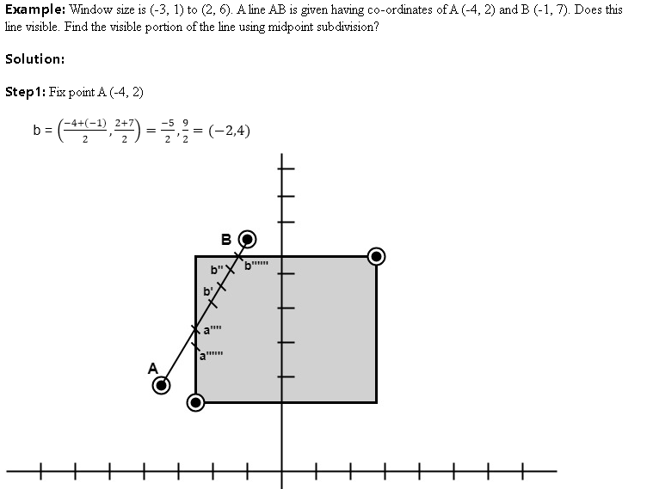
Example

Slide 45
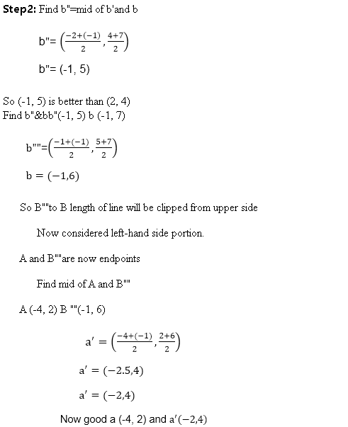

Slide 46
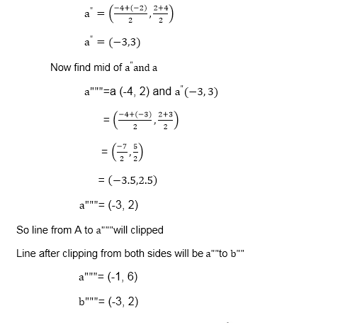

Slide 47
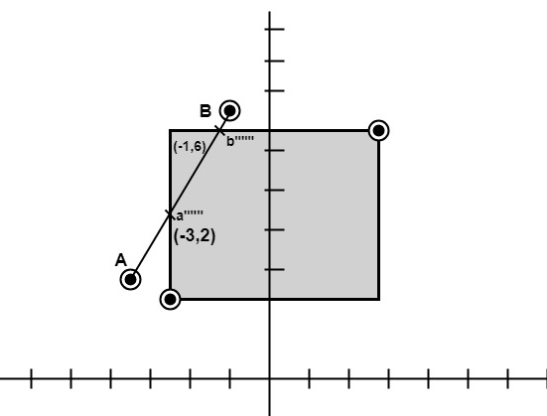

Slide 48
Polygon Clipping
Graphics packages typically support only fill areas that are polygons, and often only convex polygons. To clip a polygon fill area, we cannot apply a line-clipping method to the individual polygon edges directly because this approach would not, in general, produce a closed polyline. Instead, a line clipper would often produce a disjoint set of lines with no complete information about how we might form a closed boundary around the clipped fill area.

Slide 49
Polygon Clipping
not just clipping all boundary lines
  may have to introduce new line segments

Slide 50
Area Clipping
Similarly to lines, areas must be clipped to a window boundary
Consideration must be taken as to which portions of the area must be clipped

Slide 51
Sutherland-Hodgman Area Clipping Algorithm
An efficient method for clipping a convex-polygon fill area, developed by Sutherland and Hodgman, is to send the polygon vertices through each clipping stage so that a single clipped vertex can be immediately passed to the next stage.
This eliminates the need for an output set of vertices at each clipping stage, and it allows the boundary-clipping routines to be implemented in parallel. The final output is a list of vertices that describe the edges of the clipped polygon fill area.

Slide 52
Sutherland-Hodgman Area Clipping Algorithm
Sutherland
turns up
again. This
time with
Gary Hodgman with whom he worked at the first ever graphics company Evans & Sutherland
A technique for clipping areas
developed by Sutherland &
Hodgman
Put simply the polygon is clipped
by comparing it against each
boundary in turn
Original Area
Clip Left
Clip Right
Clip Top
Clip Bottom

Slide 53
Sutherland-Hodgeman Algorithm

Slide 54
Sutherland-Hodgeman Clipping
basic idea:
  consider each edge of the viewport individually
  clip the polygon against the edge equation
  after doing all edges, the polygon is fully clipped

Slide 55
Sutherland-Hodgeman Clipping
basic idea:
  consider each edge of the viewport individually
  clip the polygon against the edge equation
  after doing all edges, the polygon is fully clipped

Slide 56
Sutherland-Hodgeman Clipping
basic idea:
  consider each edge of the viewport individually
  clip the polygon against the edge equation
  after doing all edges, the polygon is fully clipped

Slide 57
How many sides?
Seven…

Slide 58
Sutherland-Hodgeman Clipping
edge from s to p takes one of four cases:
  (blue line can be a line or a plane)
inside
outside
inside
outside
inside
outside
inside
outside
p
s
p
s
p
s
p
s
p output
i output
no output
i output
p output

Slide 59
Sutherland-Hodgman Area Clipping Algorithm (cont…)
To clip an area against an individual boundary:
  Consider each vertex in turn against the boundary
  Vertices inside the boundary are saved for clipping against the next boundary
  Vertices outside the boundary are clipped
  If we proceed from a point inside the boundary to one outside, the intersection of the line with the boundary is saved
  If we cross from the outside to the inside intersection point and the vertex are saved

Slide 60
Sutherland-Hodgman Example
Each example shows the point being processed (P) and the previous point (S)
Saved points define area clipped to the boundary in question
S
S
P
I
P
Save Point P
Save Point I
P
S
I
P
S
No Points Saved
Save Points I & P

Slide 61
Example
P.T.O

Slide 62
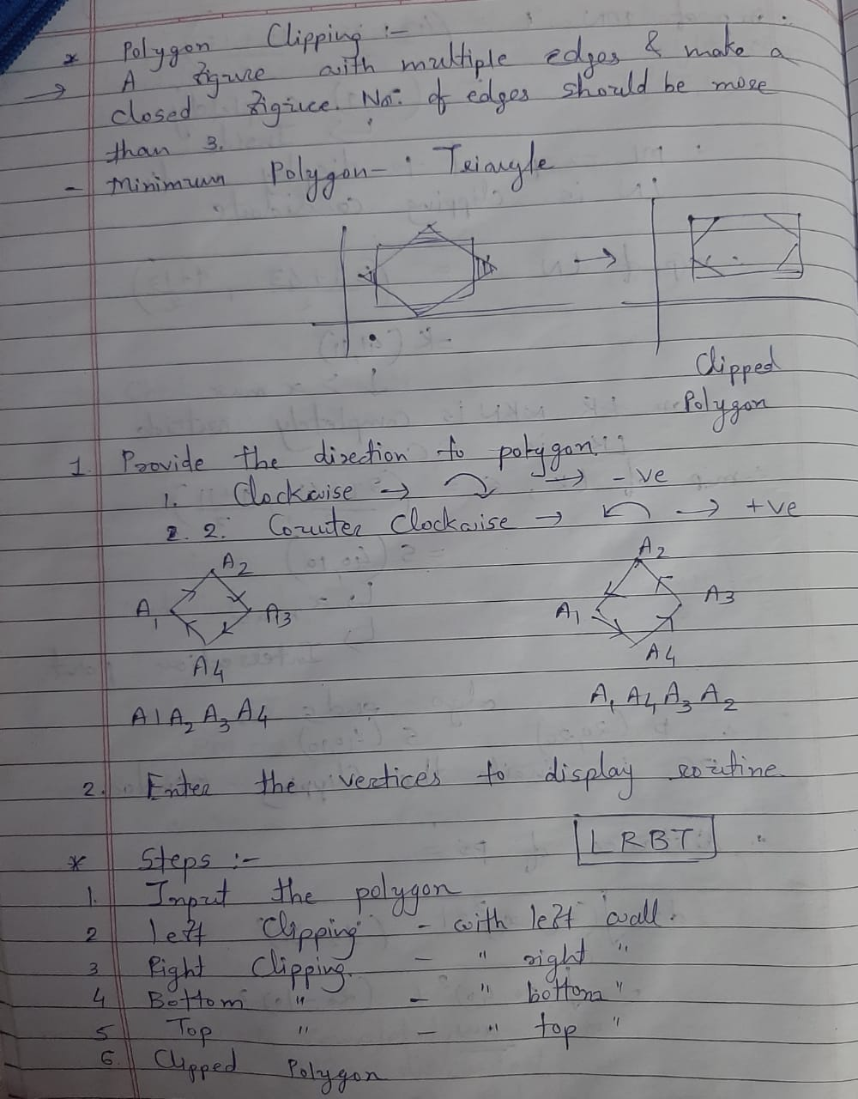

Slide 63
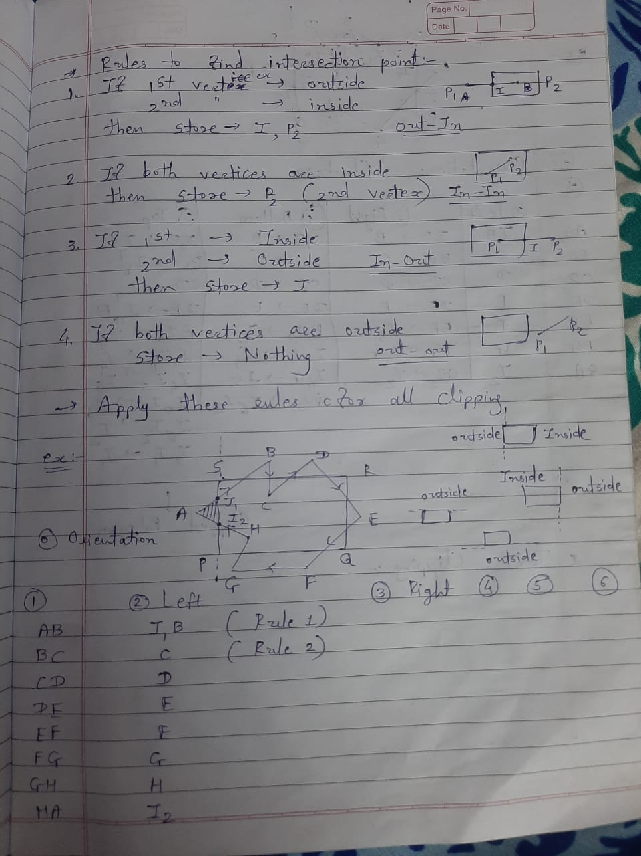

Slide 64
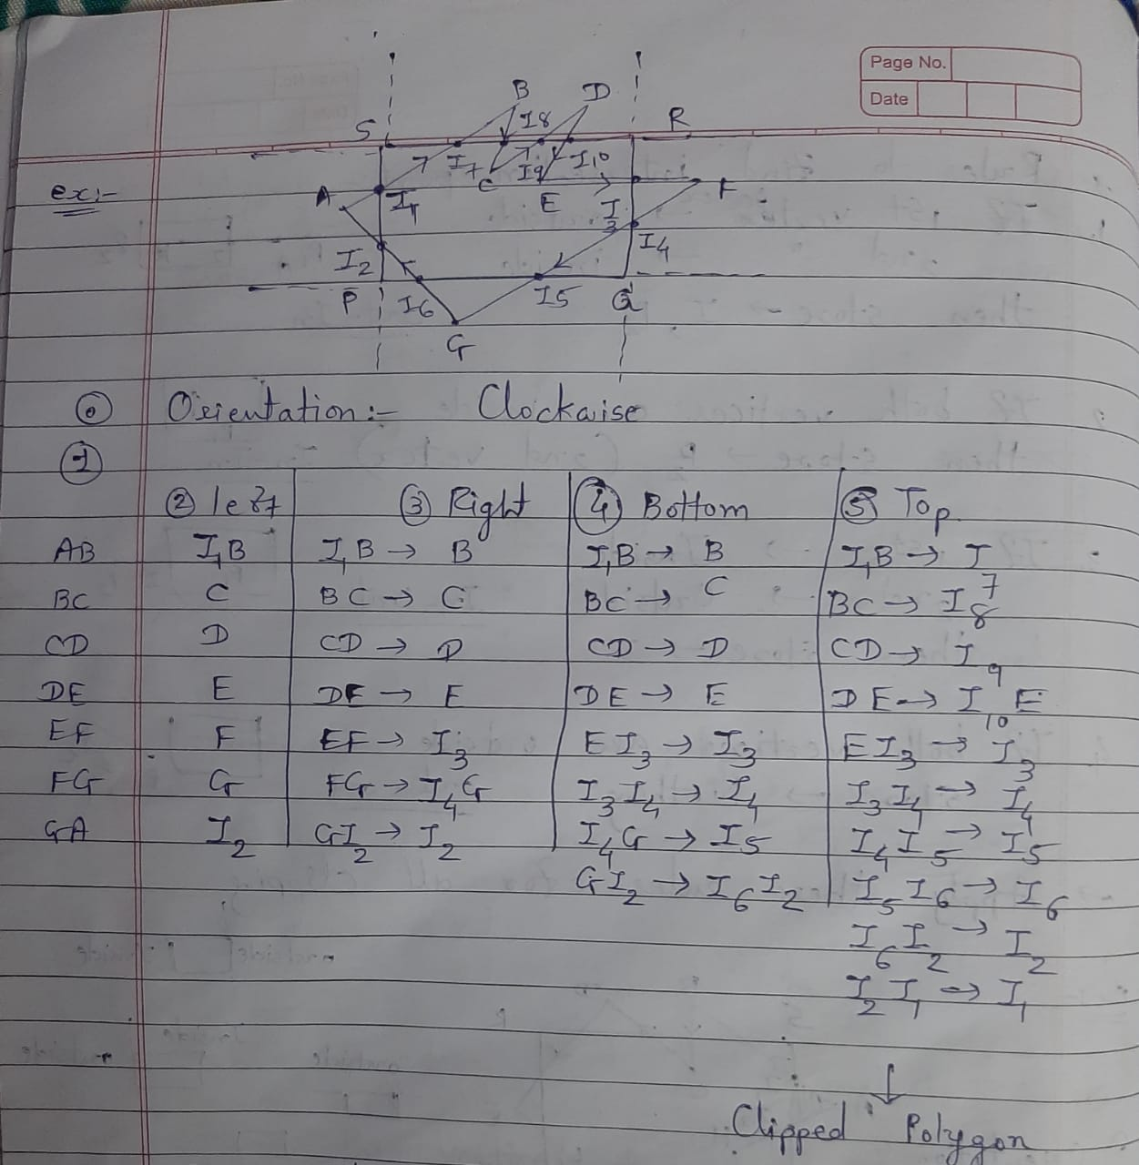

Slide 65
Polygon Clipping Using Nonrectangular Polygon Clip Windows
Parametric line-clipping methods are particularly well suited for processing polygon fill areas against convex-polygon clipping windows.
In this approach, we use a parametric representation for the edges of both the fill area and the clipping window, and both polygons are represented with a vertex list. We first compare the positions of the bounding rectangles for the fill area and the clipping polygon.
If we cannot identity the fill area as completely outside the clipping polygon,we can use inside-outside tests to process the parametric edge equations. After completing all the region tests, we solve pairs of simultaneous parametric line equations to determine the window intersection positions.

Slide 66
Polygon Clipping Using Nonlinear Clipping-Window Boundaries
One method for processing a clipping window with curved boundaries is to approximate the boundaries with straight-line sections and use one of the algorithms for clipping against a general polygon-shaped clipping window.
we could use the same general procedures that we discussed for line segments. First, we can compare the coordinate extents of the fill area to the coordinate extents of the clipping window. Depending on the shape of the clipping window, we may also be able to perform some other region tests based on symmetric considerations. For fill areas that cannot be identified as completely inside or completely outside the clipping window, we ultimately need to calculate the window intersection positions with the fill area.

Slide 67
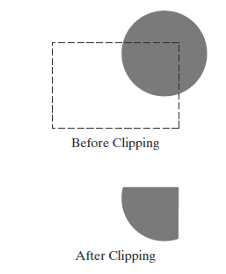
Curve Clipping
Areas with curved boundaries can be clipped with methods similar to those discussed in the previous sections. If the objects are approximated with straight-line boundary sections, we use a polygon-clipping method. Otherwise, the clipping procedures involve nonlinear equations, and this requires more processing than for objects with linear boundaries.

Slide 68
3D CLIPPING

Slide 69
Three-Dimensional
Viewing Concepts
When we model a three-dimensional scene, each object in the scene is typically defined with a set of surfaces that form a closed boundary around the object interior.
Characteristics:
Projections
Depth Cueing
Identifying Visible Lines and Surfaces
Surface Rendering
Exploded and Cutaway Views

Slide 70
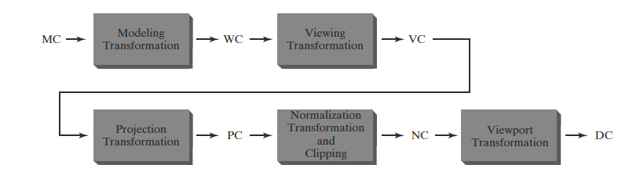
Three-Dimensional Viewing pipeline

Slide 71
3D Clipping
Computer Graphics
Just like the case in two dimensions, clipping removes objects that will not be visible from the scene
The point of this is to remove computational effort
3-D clipping is achieved in two basic steps
  Discard objects that can’t be viewed
    i.e. objects that are behind the camera, outside the field of view, or too far away
  Clip objects that intersect with any clipping plane

Slide 72
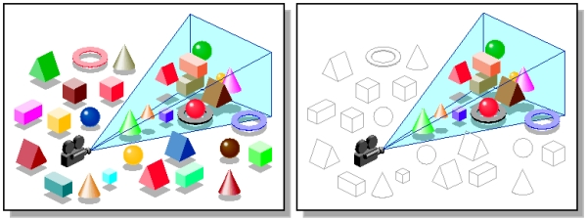
3D Clipping
Computer Graphics
Discarding objects that cannot possibly be seen involves comparing an objects bounding box/sphere against the dimensions of the view volume
  Can be done before or after projection

Slide 73
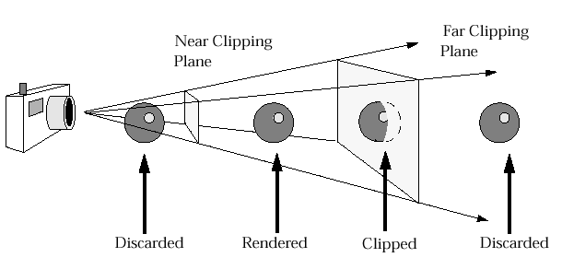
3D Clipping
Computer Graphics
Objects that are partially within the viewing volume need to be clipped – just like the 2D case

Slide 74
Clipping Volume
Computer Graphics
The window, which served as clipping boundary in two-dimensional space In three dimensional space the concept can be extended to a clipping volume or view volume.
The two common three dimensional clipping volume are a rectangular parallelepiped, i.e. a box, used for parallel or axonometric projection, and a truncated pyramidal volume used for perspective projections.

Slide 75
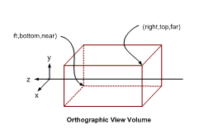
The Clipping Volume
Computer Graphics
In case of Parallel projections the infinite Parallelepiped is bounded by Near/front/hither and far/back/yon planes for clipping.

Slide 76
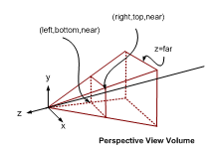
The Clipping Volume
Computer Graphics
In case of Perspective projections the semi Infinite Pyramid is also bounded by Near/front/hither and far/back/yon planes for clipping

Slide 77
Computer Graphics
The two-dimensional concept of region codes can be extended to three dimensions by considering six sides and 6-bit code instead of four sides and 4-bit code.
Like two-dimension, we assign the bit positions in the region code from right to left as…

Slide 78
Computer Graphics
Bit 1 = 1, if the end point is to the left of the volume.
Bit 2 = 1, if the end point is to the right of the volume.
Bit 3 = 1, if the end point is the below the volume.
Bit 4 = 1, if the end point is above the volume.
Bit 5 = 1, if the end point is in front of the volume.
Bit 6 = 1, if the end Point is behind the volume.
Otherwise, the bit is set to zero. As an example, a region code of 101000 identifies a point as above and behind the view volume, and the region code 000000 indicates a point within the view volume.

Slide 79
Clipping Strategies
Computer Graphics
Two types of clipping strategies are followed:
  Direct Clipping: The clipping is done directly against the view volume.
  Canonical Clipping: Normalization transformations are applied which transform the original view volume into normalized (canonical) view volume. Clipping is then performed against canonical view volume.

Slide 80
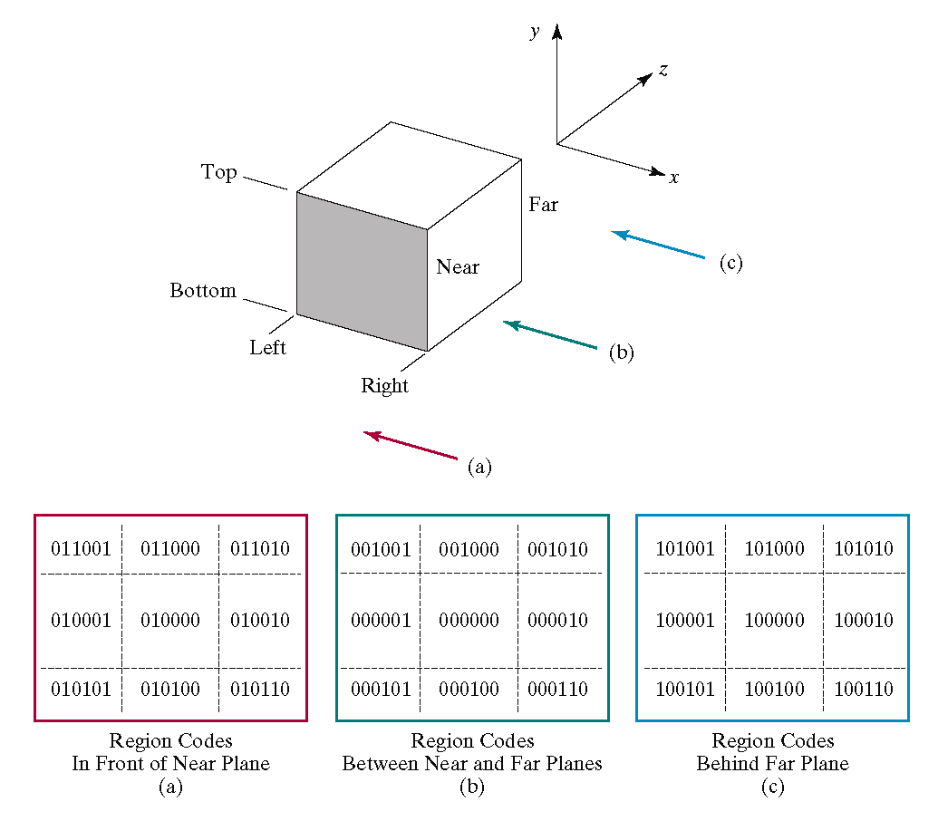

Region Codes
Images taken from Hearn & Baker, “Computer Graphics with OpenGL” (2004)

